Slide 1
Body systems
Birth

Slide 2
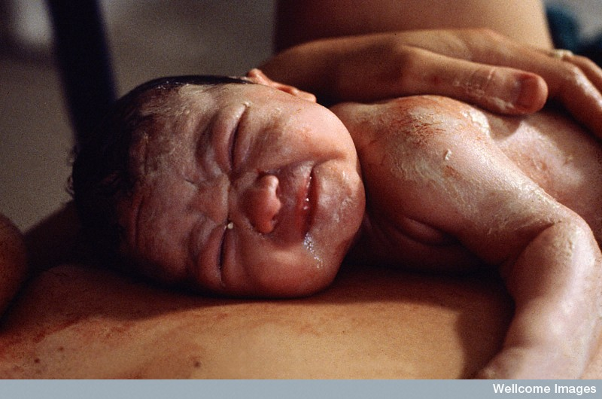
Newborn – the neonate
The vernix is a protective layer of wax covering the babies skin
Anthea Sieveking, Wellcome Images

Slide 3
The blood-circulatory system
At birth the following circulatory changes take place:
  The umbilical arteries and vein stop functioning
  The hepatic shunt (ductus venosus) closes and the hepatic circulation becomes fully functional
  The two cardiac shunts (ductus aeteriosus & foramen ovale) close and the pulmonary circulation becomes fully functional

Slide 4
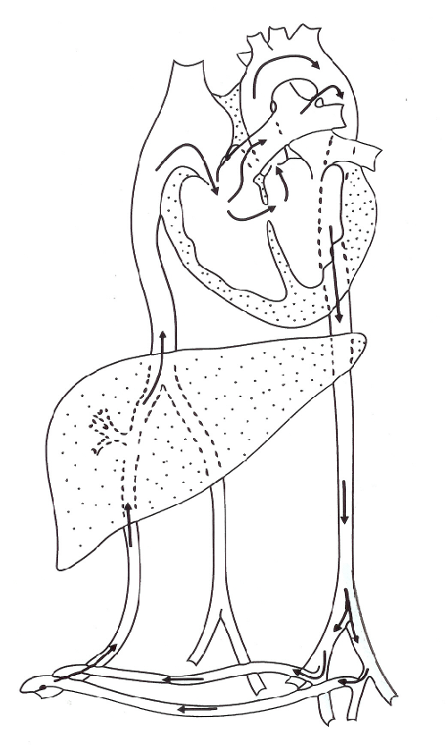
Changes in the circulation
Ductus arteriosus
Foramen ovale
Ductus venosus
Umbilical arteries and vein

Slide 5
Ductus Venousus
In the foetus this duct allows most blood to bypass the liver and enter the vena cava. At this stage the liver is not needed to fully function.
After birth this duct closes to allow all blood to flow through the liver.

Slide 6
Ductus Arteriosus
This duct is a by pass so that most blood does not need to travel to the lungs from the right ventricle. Instead it is able to join the aorta to travel to the foetus’s body.
After birth the blood needs to circulate through the lungs and so this duct closes.

Slide 7
Foramen Ovale
This is an opening in the heart that allows blood to travel directly from the right atrium into the left atrium and so on to the aorta. This is another short cut to avoid the lungs which are not functioning.
After birth this closes over. Children born where this fails to close are often called “hole in the heart” babies.

Slide 8
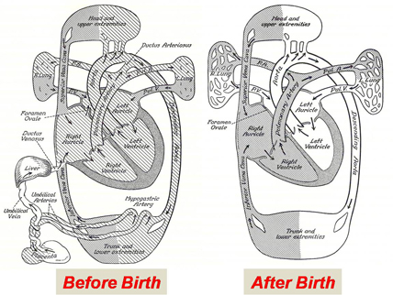

Slide 9
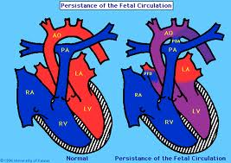

Slide 10
Change at birth
The process of being born causes a complex chain reaction in the babies body in order to suddenly survive in the outside world.
1. The shock of birth usually triggers the first breath ( if not the traditional slap on the bottom helps). In animals they are often vigorously licked by their mothers or in some cases such as in elephants, the fall from a great height helps the young to suddenly breathe for the first time.

Slide 11
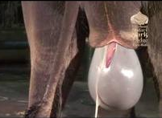
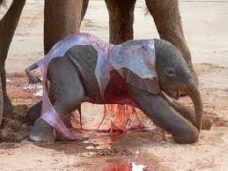

Slide 12
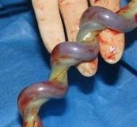
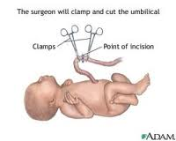
Failing this the clamping of the umbilical vessels allows the carbon dioxide in the baby’s blood to rise and so stimulate the reparatory centre in the brain – causing the lungs to start to function.

Slide 13
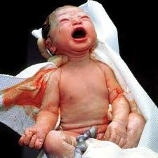
2. As the lungs expand they no longer offer the same resistance to blood flow, so blood flow through the ductus arteriosus is decreased. This duct will completely disappear a few weeks after birth.

Slide 14
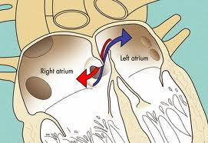
3. As large amounts of blood return from the lungs to the heart. The pressure in the left atrium increases. This increased pressure forces the flap of the foramen ovale against the wall of the atrium, closing the opening. Eventually this will close permanently.

Slide 15
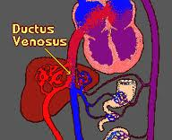
4. With the umbilical cord cut blood no longer flows through the umbilical vessels to the ductus venosus. Due to the lack of blood this duct gradually constricts and closes off. The bypass around the liver is then closed and all blood must now pass through the liver.

Slide 16
Caesarean Section
A C-section is where the baby is surgically removed from the uterus. This is done when:
The placenta is too low
The baby is overdue and no labour has started
When there is medical risks to mother or baby

Slide 17
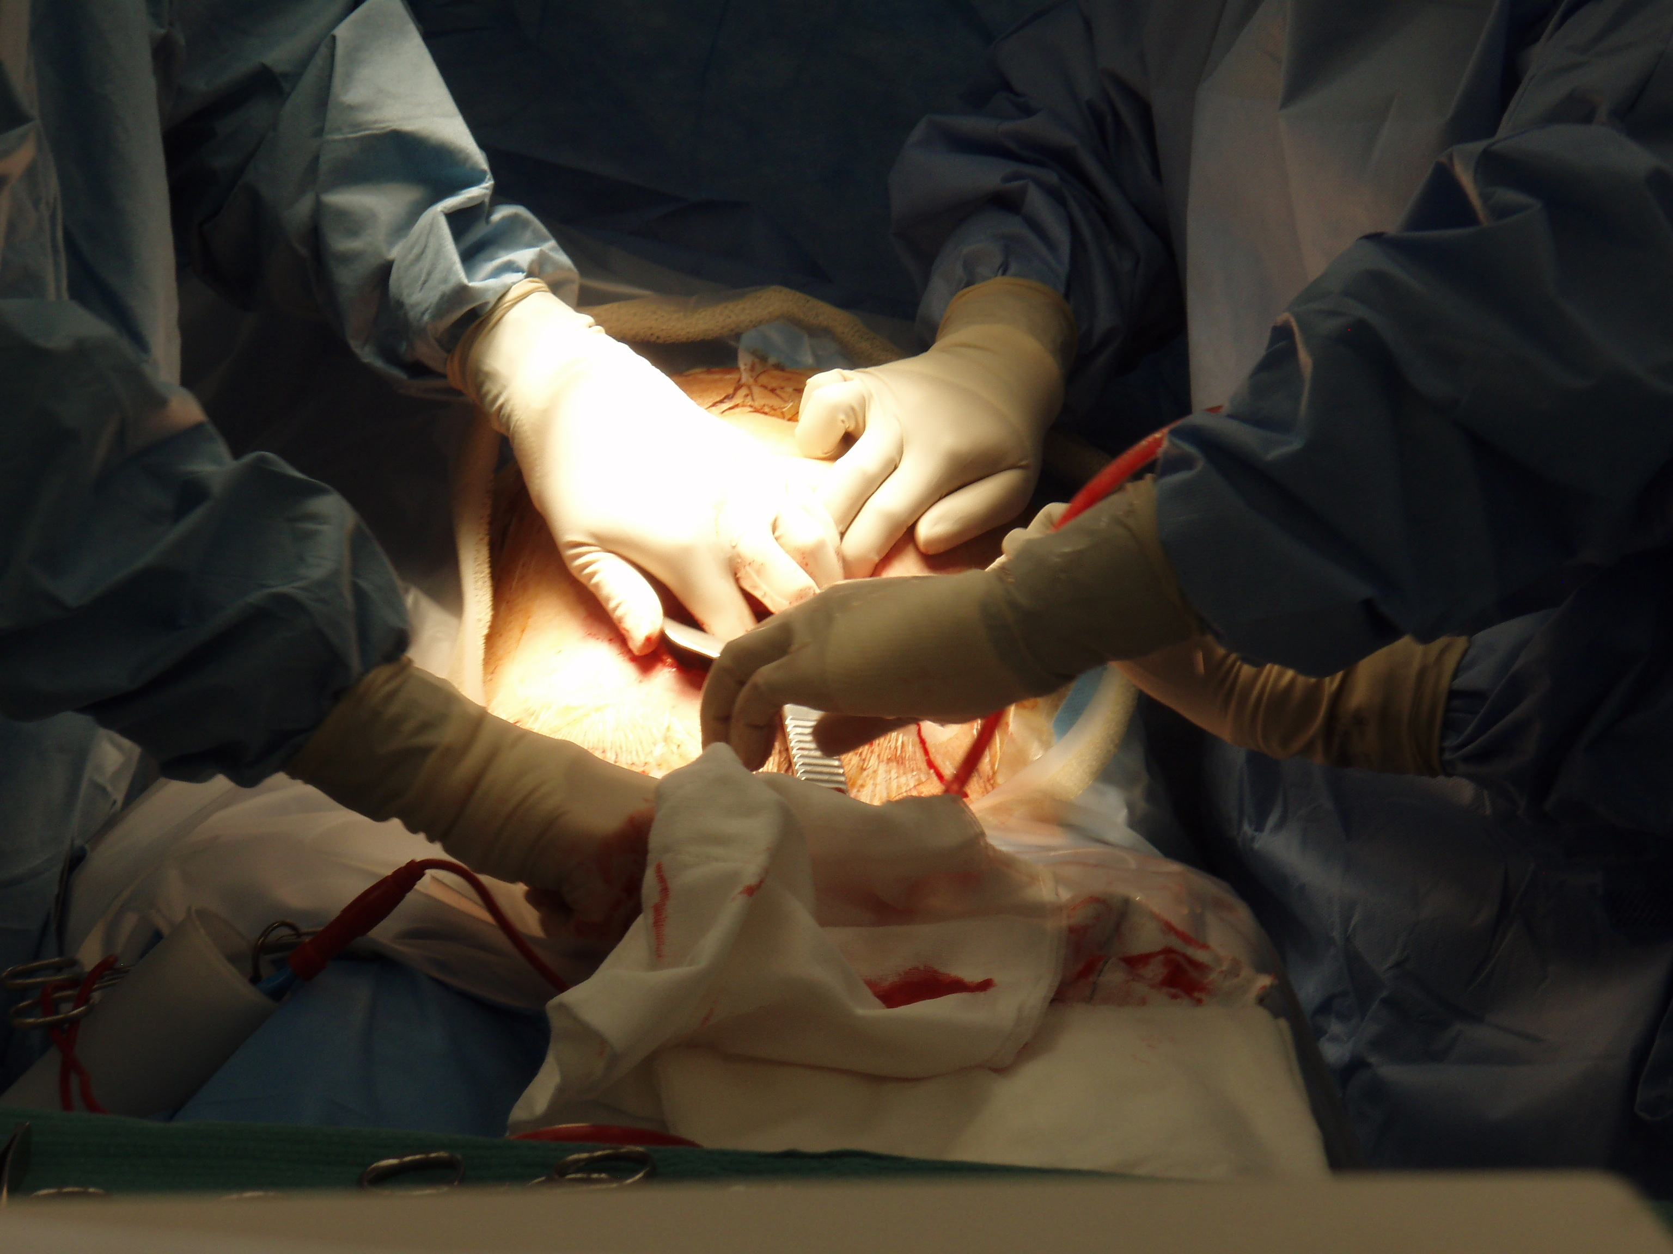

Slide 18
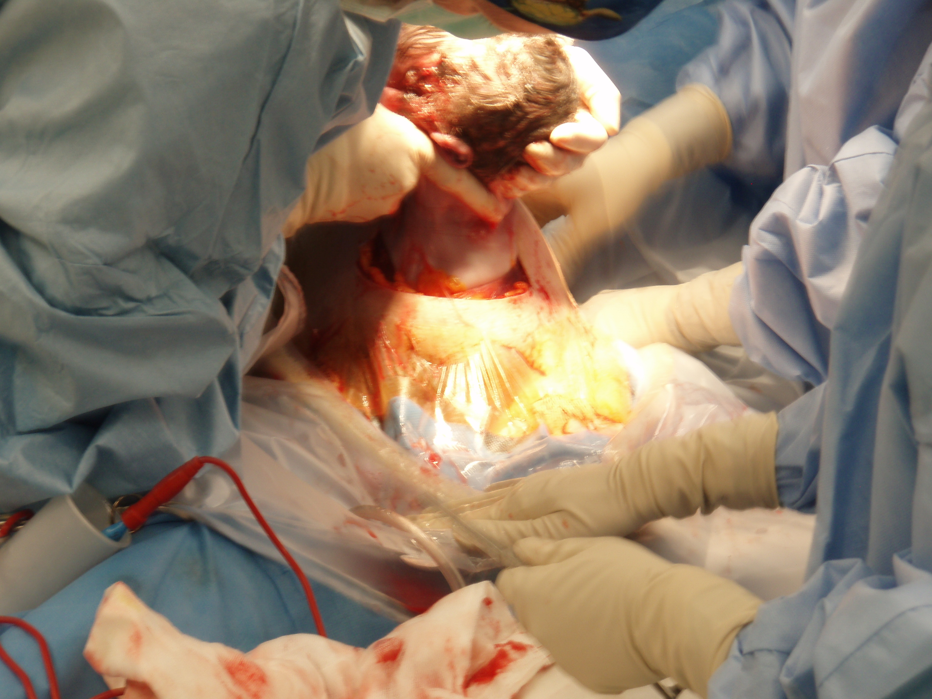

Slide 19
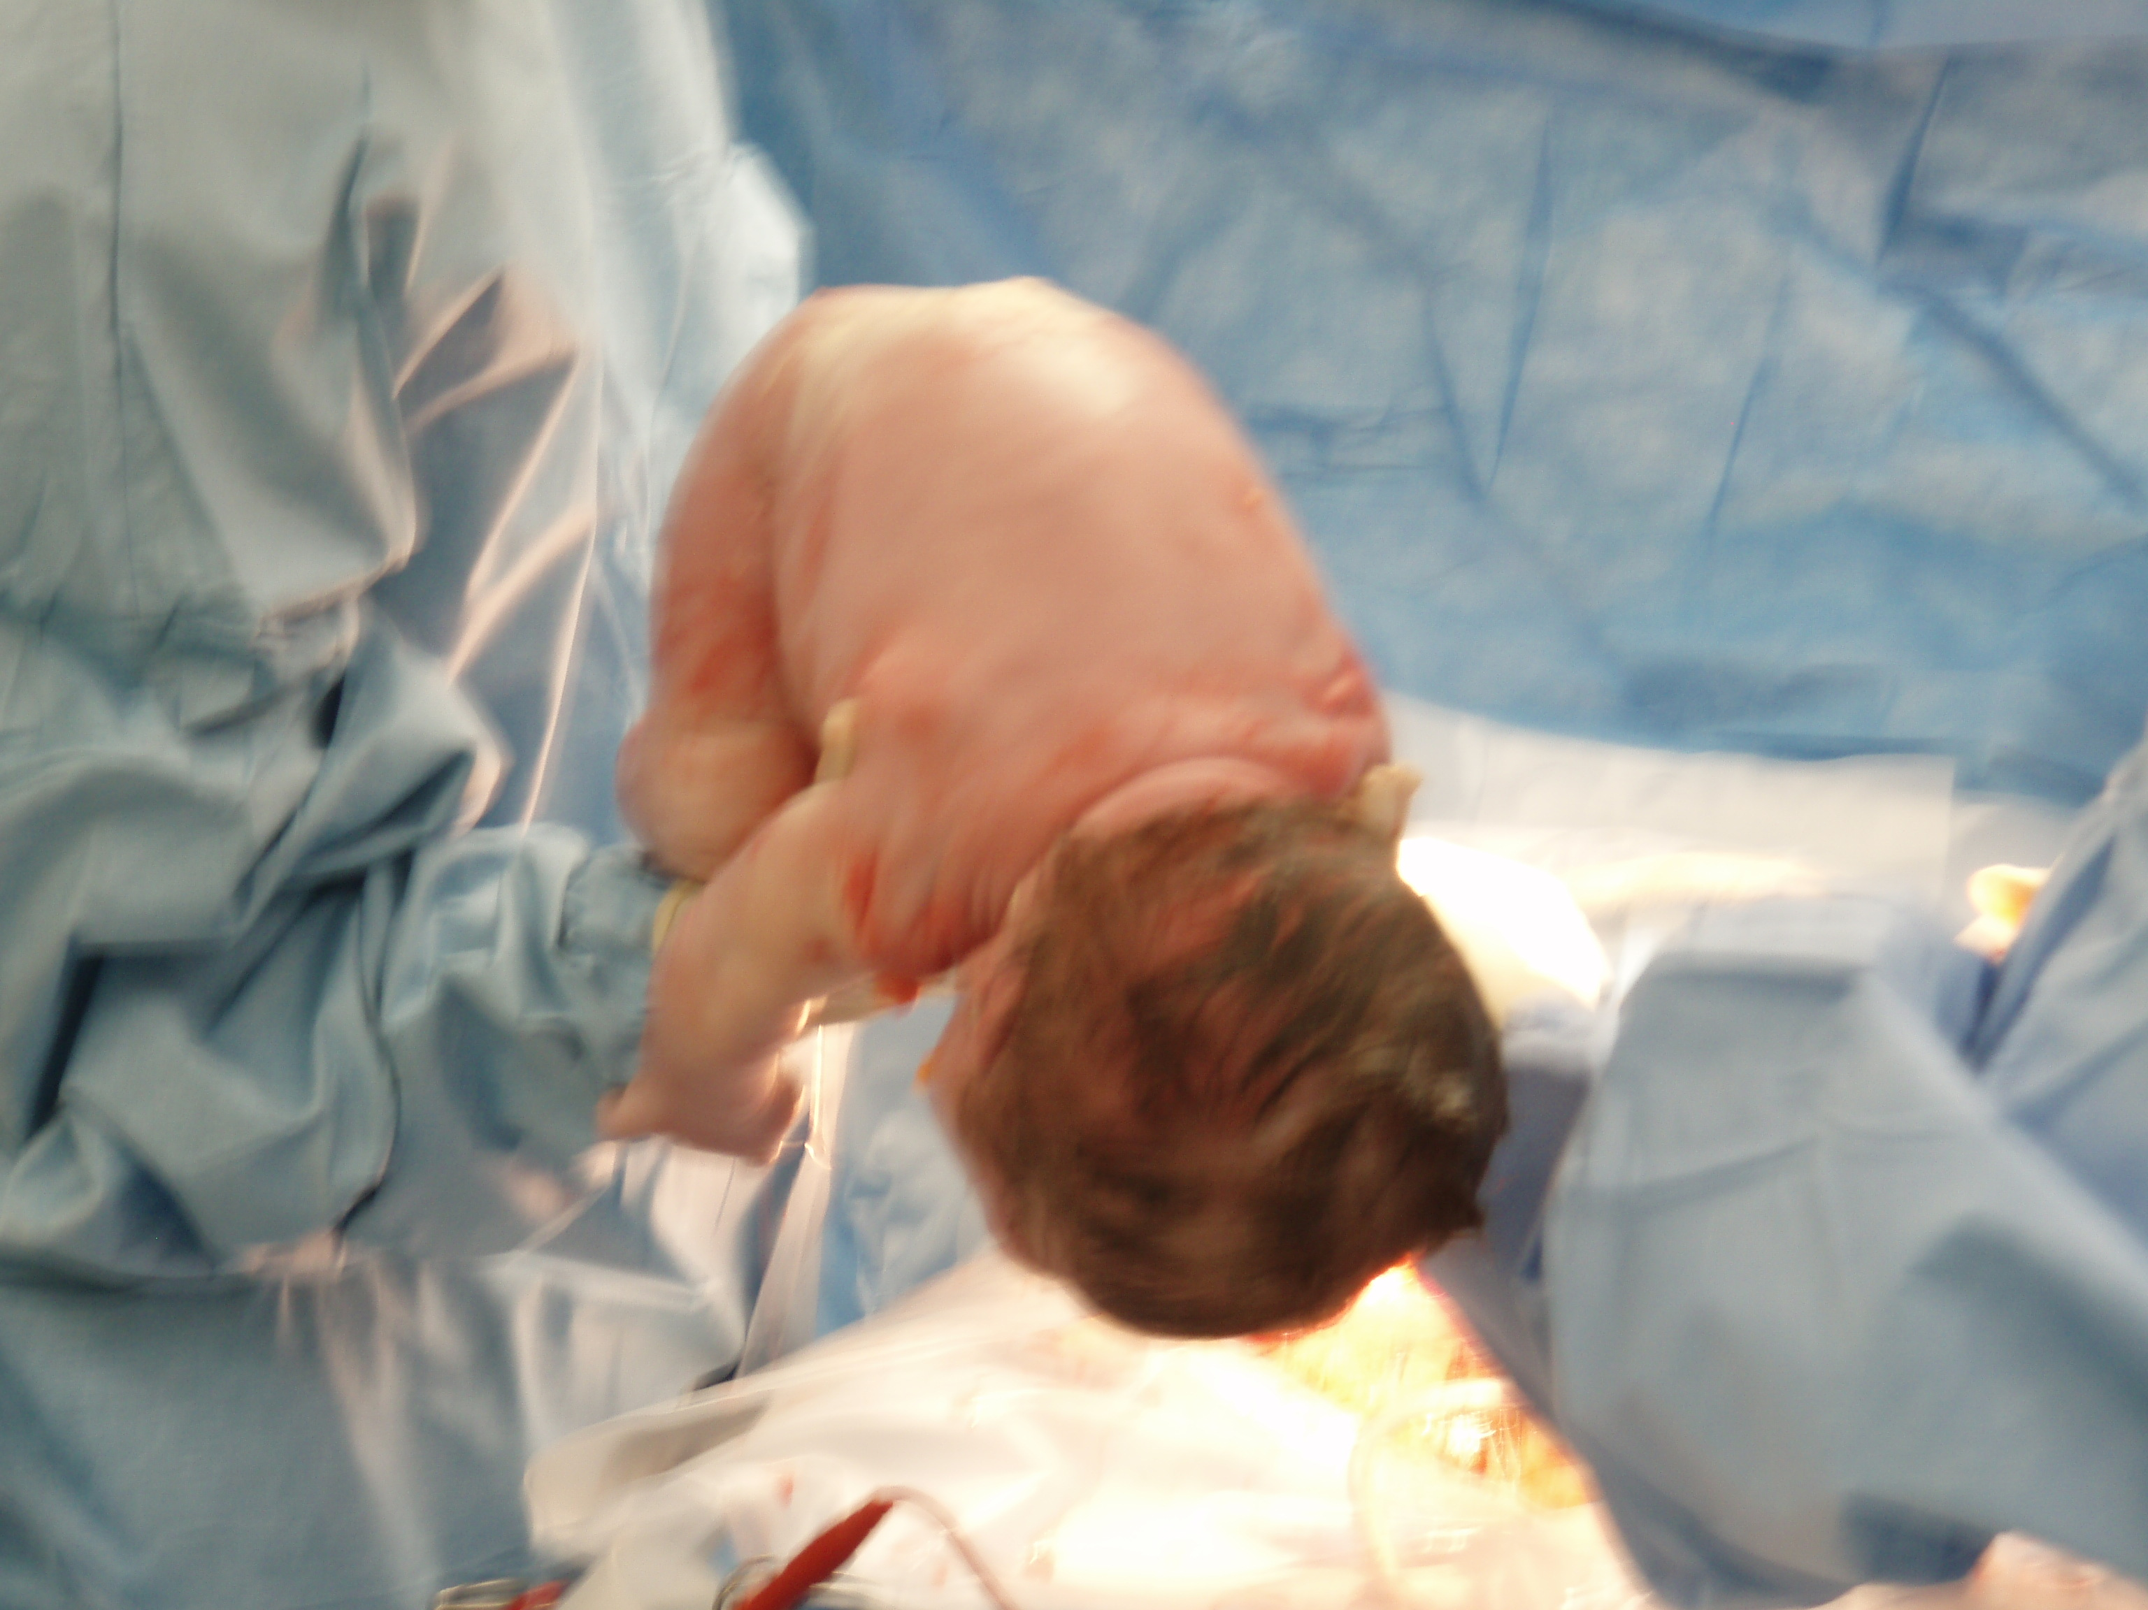

Slide 20
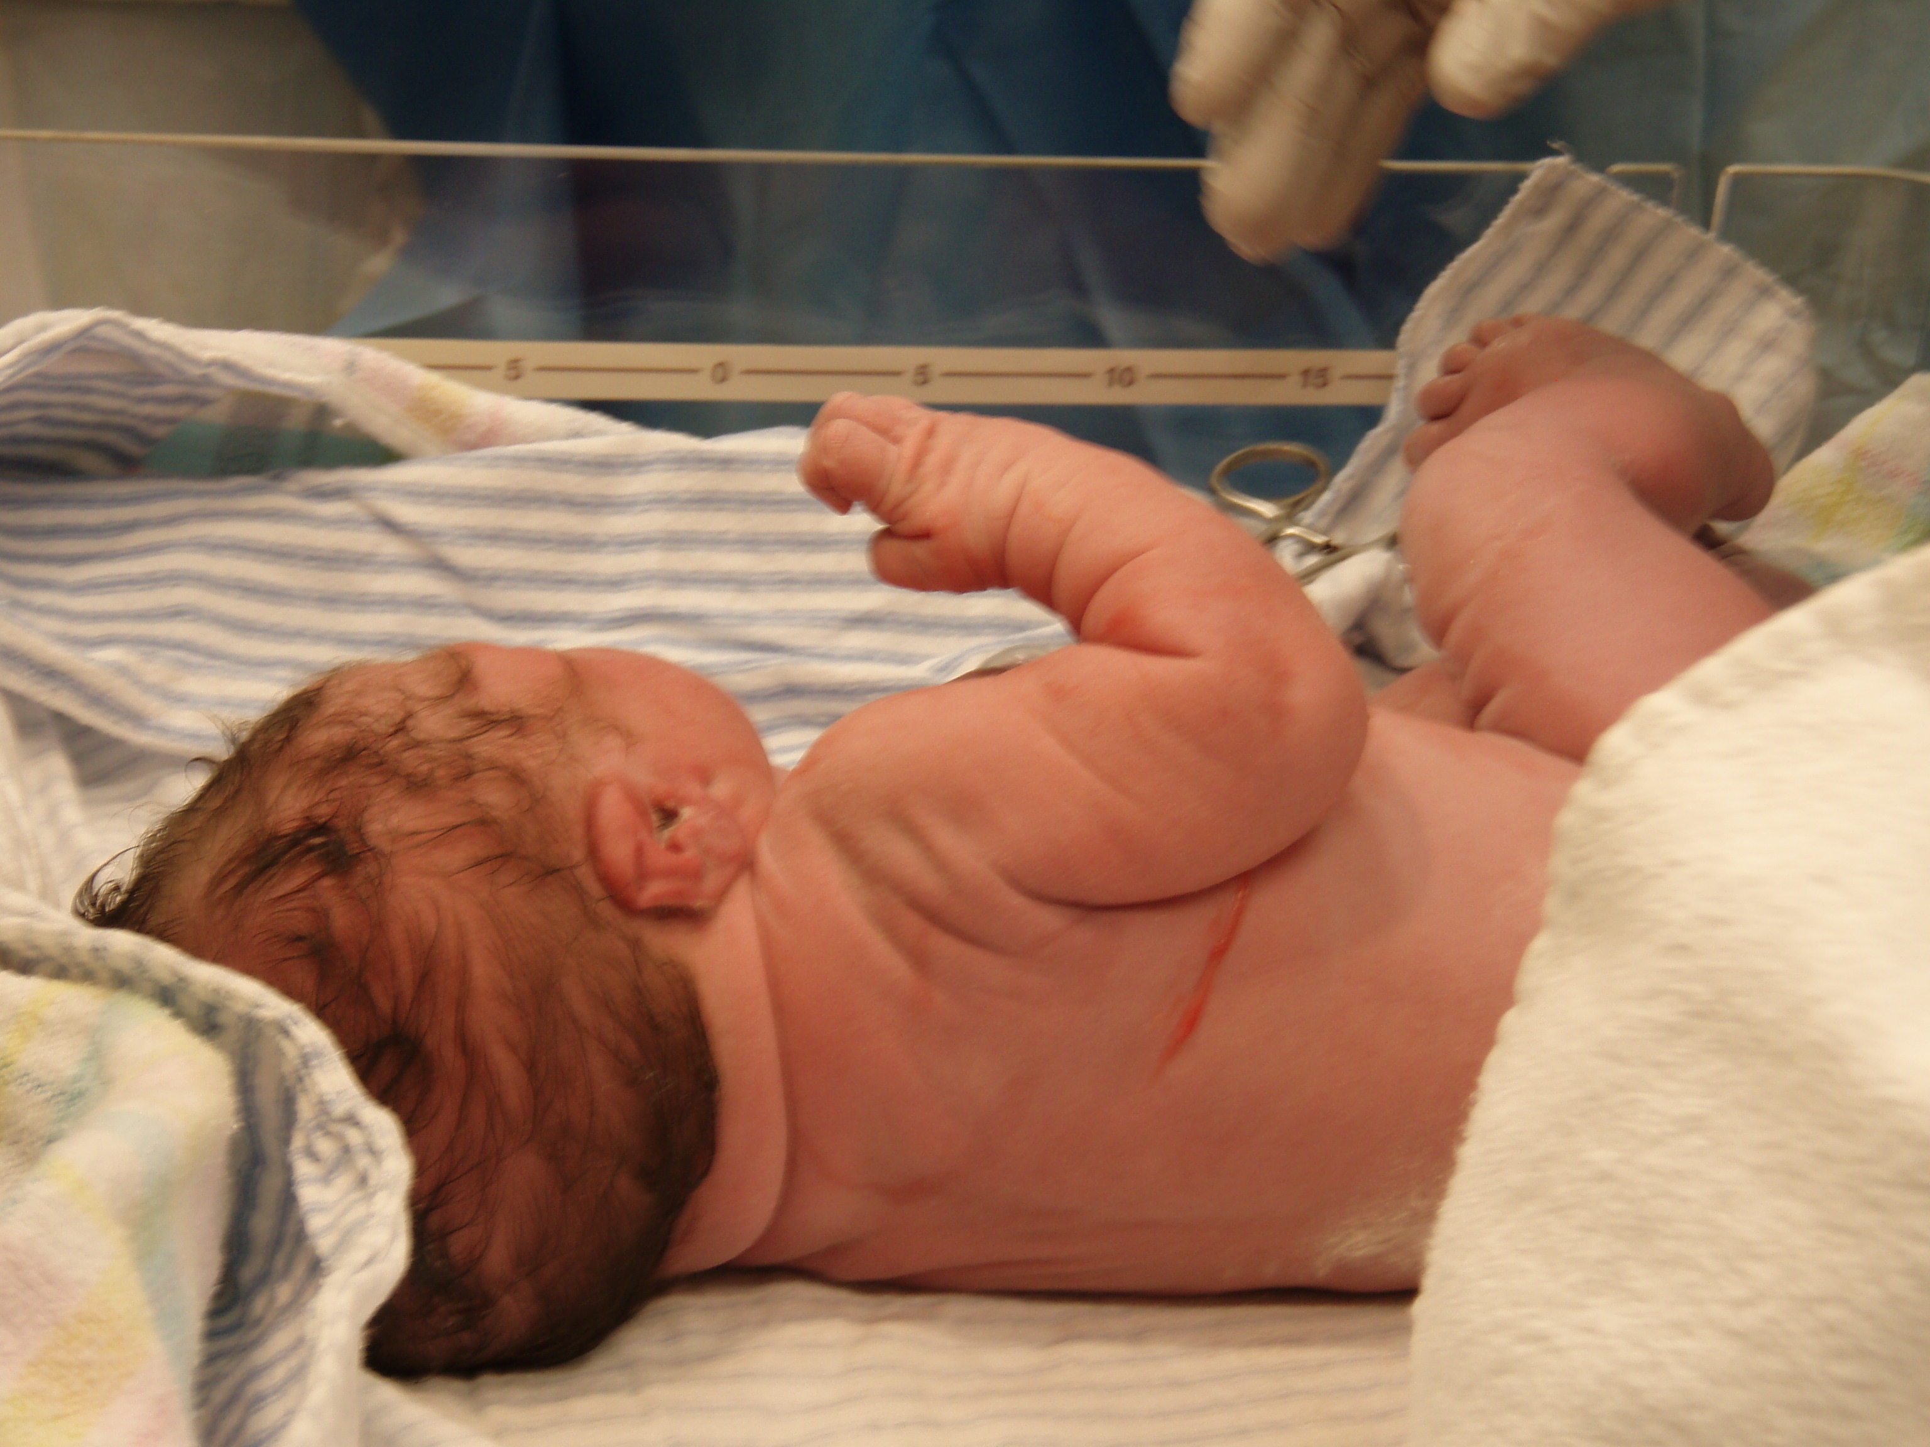

Slide 21
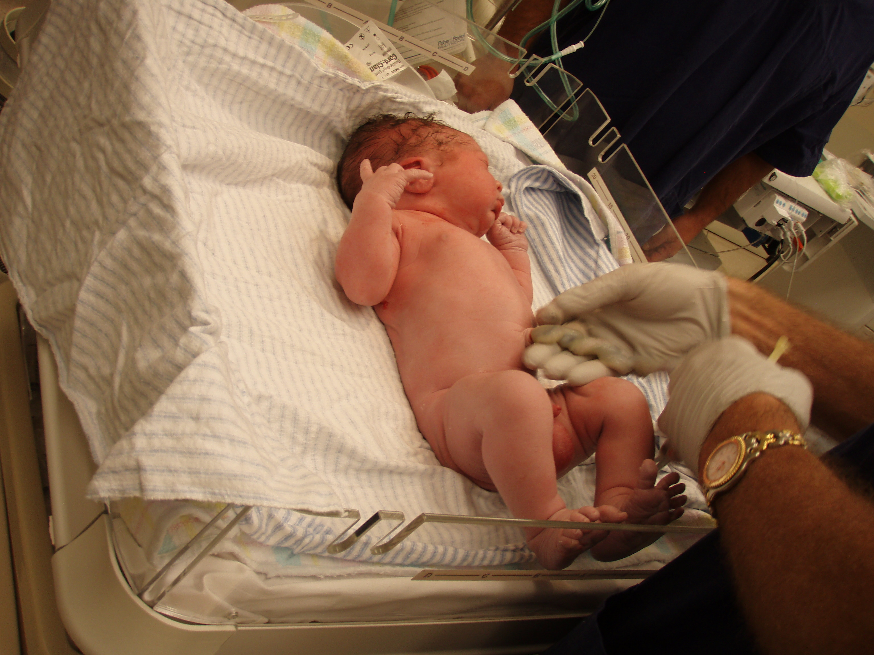

Slide 22
Puerperium
This is the time period post birth until 8 weeks.
During this time a number of changes occur for the mother.
Uterus continues to contract in order to return to original shape.
Uterus discharges a mixture of blood and other tissues (up to 3rd week).
Blood volume reduces.
Pulse rate reduces.

